Slide 1

Regional SME support strategies – best practise examples from
European Enterprise Promotion Awards
Qazakh, June 17
The project “Development of SME strategies and its impact on regional SMEs” benefits from support through the EaP Civil Society Forum Re-granting Scheme (FSTP) and is funded by the European Union as part of its support to civil society in the region. This material has been produced with the assistance of the European Union. The contents of this publication are the sole responsibility of project implementing partners and do not necessarily reflect the views of the European Union.

Slide 2

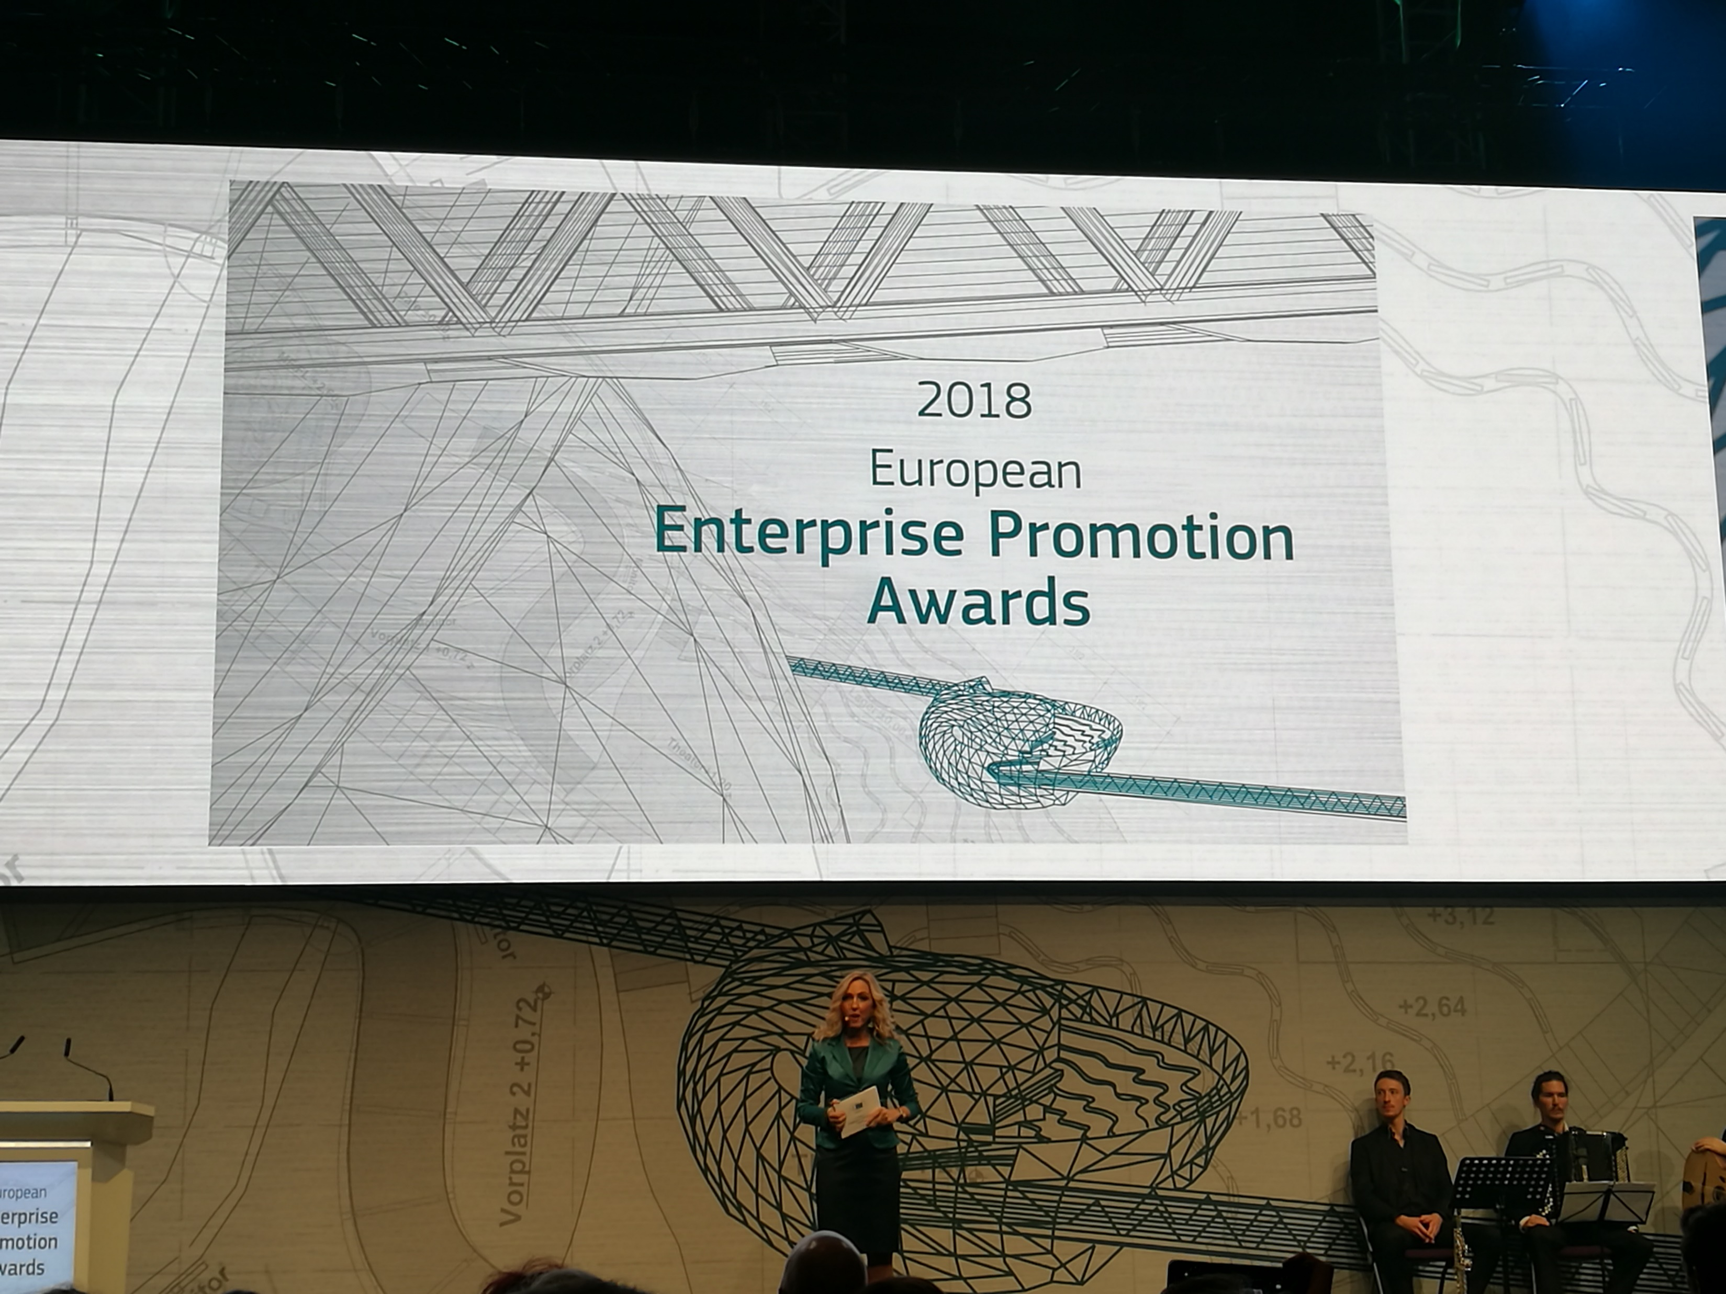
EUROPEAN ENTERPRISE PROMOTION AWARD #EEPA
The winners are announced at an awards ceremony at the SME Assembly, which is part of European SME Week.
https://ec.europa.eu/growth/smes/support/enterprise-promotion-awards_en

Slide 3
EUROPEAN ENTERPRISE PROMOTION AWARD #EEPA
Categories:
Grand Jury prize
Promoting the Entrepreneurial Spirit
Investing in Entrepreneurial Skills
Improving the Business Environment
Supporting the Internationalisation of Business
Supporting the Development of Green Markets and Resource Efficiency
Responsible and Inclusive Entrepreneurship
Special Mentions
National Winners

Slide 4
EUROPEAN ENTERPRISE PROMOTION AWARD #EEPA
identify and recognise successful activities and initiatives undertaken to promote enterprise and entrepreneurship
showcase and share examples of best entrepreneurship policies and practices
create a greater awareness of the role entrepreneurs play in society
encourage and inspire potential entrepreneurs.

Slide 5
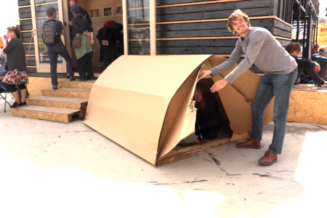
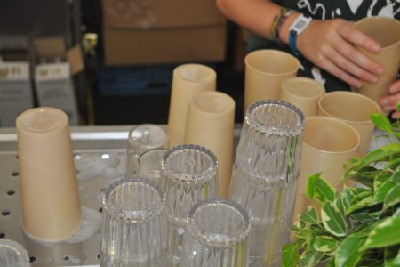
INNOFEST - Netherlands
Grand prize winner 2017
Providing possibility to test innovative, green ideas at existing music festivals
The project has set up 36 innovation projects. In two years helped around 60 entrepreneurs and 100 students test their concepts at festivals
Further information: www.innofest.co

Slide 6

  ACORNS - Ireland
Investing in Entrepreneurial Skills, Runner -up 2018
Peer to peer support programme in which successful businesswomen (Lead Entrepreneurs) voluntarily facilitate groups of early stage female entrepreneurs in rural Ireland.
The aim of the programme is to create sustainable businesses throughout rural Ireland to create more jobs over time
Further information: www.acorns.ie

Slide 7
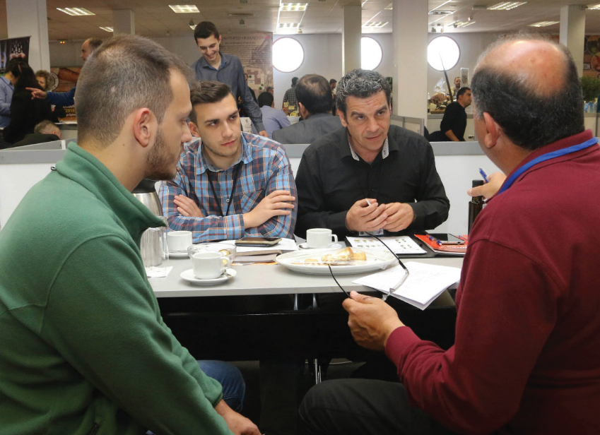
  PANCRETAN FORUM - Greece
Special mentions – 2016
Forum for the introduction of local products in local hotels
Annual business event that facilitates partnerships between hoteliers and farmers/processors/ suppliers of agricultural products
Further information: www.ebeh.gr

Slide 8
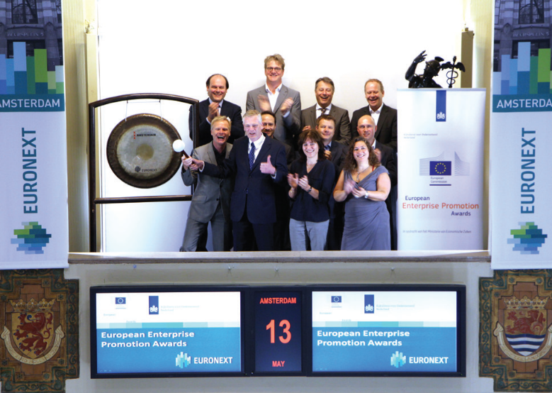
  DE ROTTERDAMSE ZAAK - Netherlands
Responsible and Inclusive Entrepreneurship – Winner 2016
Students in higher vocational education and experienced business coaches help entrepreneurs to improve business practices and entrepreneurial skills
Focus on entrepreneurs who operate below the poverty line and are not financially able to find a solution to their problems
Further information: www.derotterdamsezaak.nl

Slide 9
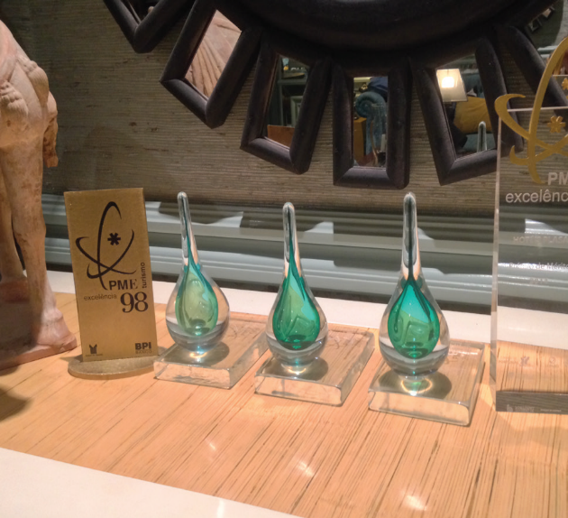
  PME Lider (SME LEADER) - Portugal
Improving the Business Environment - Winner 2016
Annual award in co-operation with banks that rewards SMEs with the best financial performance and risk levels.
Winners benefit from more favourable conditions for accessing finance and other specialised business management support
Further information: www.apb.pt

Slide 10
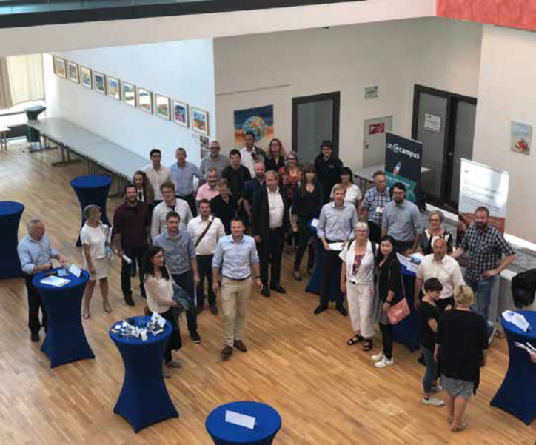
  LEAN LANDING - Denmark
Grand Jury Prize – Winner 2018
Designed to get small businesses into new European markets
Creates partnerships to allow market-test new products in target markets
The network has members from Denmark, Sweden, Norway, Germany, Holland and the United Kingdom
Further information: www.vhsj.dk

Slide 11
  More winning ideas
EEPA Awards 2018 Compendium https://blogs.ec.europa.eu/promotingenterprise/files/2018/11/EEPA_2018_Compendium_Brochure_EN_WEB_FINAL_V3.pdf
EEPA Awards 2017 Compendium https://blogs.ec.europa.eu/promotingenterprise/files/2017/11/EEPA_2017_Compendium_Brochure_en.pdf
EEPA Awards 2016 Compendium https://blogs.ec.europa.eu/promotingenterprise/files/2016/11/EEPA-Compendium-2016_en.pdf
Further information: www.vhsj.dk

Slide 12


Contact me:
Gunta Misāne
Advisor to Business Union of Latvia,
Chairwoman of «Comperio», Ltd
gunta@comperio.lv
www.savieniba.lv

