Slide 1

SME STRATEGIES AND ITS IMPACT ON REGIONAL SMEs in LATVIA
Qazakh, June 17
The project “Development of SME strategies and its impact on regional SMEs” benefits from support through the EaP Civil Society Forum Re-granting Scheme (FSTP) and is funded by the European Union as part of its support to civil society in the region. This material has been produced with the assistance of the European Union. The contents of this publication are the sole responsibility of project implementing partners and do not necessarily reflect the views of the European Union.

Slide 2

Agenda
Who We are
  Business Union of Latvia
  SMEs in Latvia
What we do
  Initiative “Support small business!”
  Index «Most Investment-Friendly Municipality»
Other regional initiatives

Slide 3

About Business union of Latvia
Reorganised in 2015 by merging of two employers’ organisations:
  Forum of Small and medium size enterprises of Latvia (since 2012);
  Small and medium size enterprises of Latvia (since 1996).
Unites 70 legal entities (59 enterprises and 11 associations)
Full member of UEAPME since 2013;
Represents SMEs of Latvia at national, European and international level.
Managed by one chairman of the board and 9 council members.

Slide 4
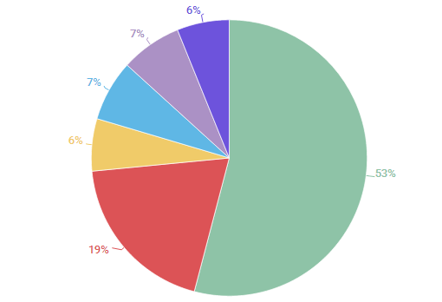
SMEs in Latvia by teritory
Riga
Around Riga
Vidzeme region
Kurzeme region
Zemgale region
Latgale region
Notes:
Prezentācijā analizēti mikro un mazie uzņēmumi, kur (jāizpildās vismaz 2 nosacījumiem):
Mikro uzņēmumam ir mazāk nekā 10 darbiniekiem un/vai apgrozījums un/vai bilance ir vienāda vai mazāka par 2 milj.EUR
Mazam uzņēmumam ir mazāk nekā 50 darbinieki un/vai kura apgrozījums un/vai bilance ir vienāda vai mazāka par 10 milj.EUR
2017.gada izskaņā Latvijā bija reģistrēti nepilni 110 tūkstoši uzņēmumi, kuri nodarbina mazāk nekā 50 darbiniekus un aizvadītajā gadā apgrozījuši mazāk nekā 10 milj.EUR vai arī to bilances kopsumma bijusi mazāka par 10 milj.EUR
Mikro un mazo uzņēmumu skaits, sadalījumā pa reģioniem:
Riga= 58320
Pieriga= 20991
Vidzeme= 7294
Kurzeme= 8704
Zemgale= 7960
Latgale= 6605

Slide 5
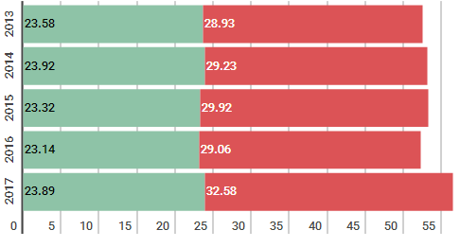
Turnover
(EUR bn)
Micro+SMEs
Other
Notes:
Pagājušajā gadā Latvijā reģistrētie uzņēmumi apgrozījuši 56,66 miljardus eiro, kas ir par 5,81% vairāk nekā 2016.gadā. Salīdzinot ar aizpagājušo gadu, pērn palielinājies arī mikro un mazo uzņēmumu kopējais apgrozījums, taču, salīdzinājumā ar Latvijas uzņēmumu kopējo rādītāju, pieaugums bijis nedaudz mazāks. Lursoft aprēķinājis, ka 2017.gadā mazais bizness apgrozīja 23,89 miljardus eiro, par 3,24% vairāk nekā nekā 2016.gadā. Tikmēr vidējā un lielā biznesa kopējais apgrozījums gada ietvaros palielinājies par 12,11%.

Slide 6
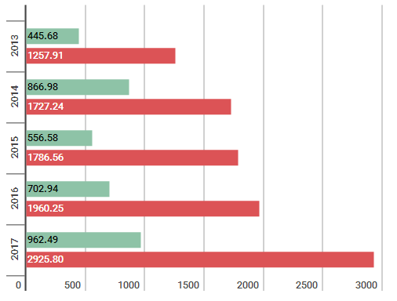
Profit, milj. EUR
Micro+SMEs
Other
Notes:
gada laikā mikro un mazo uzņēmumu peļņa palielinājusies par 36,92%, sasniedzot 962,49 milj.EUR, tikmēr valstī reģistrēto uzņēmumu kopējā peļņa augusi par 48,91%, palielinoties no 1,97 mld.EUR 2016.gadā līdz 2,93 mld.EUR pērn.

Slide 7
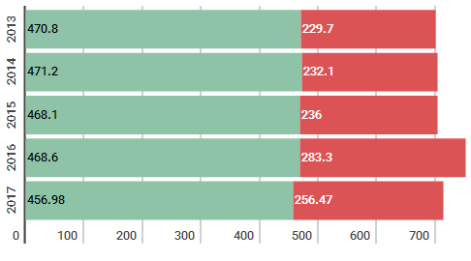
Number of employees in small business
(thsd employees)
Micro+SMEs
Other
Notes:
Mazā biznesa lielā nozīme visievērojamāk atspoguļojas, iepazīstoties ar datiem par nodarbinātību. Lursoft aprēķinājis, ka mazais bizness ar darba vietām nodrošina 64,96% no kopējā darbinieku skaita, kas 2017.gadā nodarbināts Latvijā reģistrētajos uzņēmumos. Absolūtos skaitļos tie ir 360,53 tūkstoši darbinieku, kas nodarbināti mikro uzņēmumos, un vēl 96,45 tūkstoši strādājošo uzņēmumos, kas klasificējami kā mazie uzņēmumi.

Slide 8
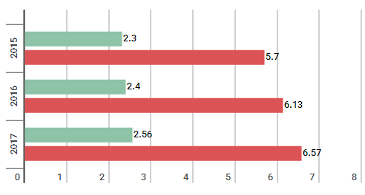
Taxes paid by Small Business
(EUR bn)
Micro+SMEs
Other
Notes:
VID administrētajos nodokļos mazais bizness 2017.gadā samaksājis 2,56 miljardus eiro, kas ir par 4,92% vairāk nekā gadu iepriekš. Vērtējot mazā biznesa pienesumu kopējo nodokļu artavā, redzams, ka tas ieņem būtisku lomu – no kopējās nodokļu summas, kuru 2017.gadā valsts kopbudžetā samaksājuši uzņēmumi, 38,96% veido tieši mazais bizness. Tiesa, iepriekšējos gados to īpatsvars bija lielāks: 2016.gadā tie bija 39,80%, bet 2015.gadā – 42,28%.

Slide 9

Initiative “Support Small Business!”

Slide 10
Origin of the initiative
Inspired by people. Entrepreneurs Kristaps Banga and Elina Egle founded organization “Forum of Small and medium companies of Latvia” (now known as Business Union of Latvia) to implement activities of “Small Business Day”.
Initiative is open, society based, non-profit and long-term.
The initiatives aim is to invite SME’s to promote their goods and services, customers – to choose SME’s products and services, and medium and large businesses to emphasize the importance of SME’s as important supply chain partner and support for local communities.
Supported by EC Commission representation office in Latvia and The Ministry of Economics of Latvia.

Slide 11

Idea
Mission: mobilisation of resources to support SMEs.
Vision: More micro/small companies with more customers.
Strategy: Attracting of new customers and partners for SMEs by joining of activities and resources, raise of awareness and education.
Tactics: „Small Business Day” as easy to access free resource for participants which provides effective communication, advertising, interaction with consumers, specific consumer groups and cooperation with other entrepreneurs.
Philosophy: less administrative burden, increase of productivity and shorten the way to consumer.

Slide 12



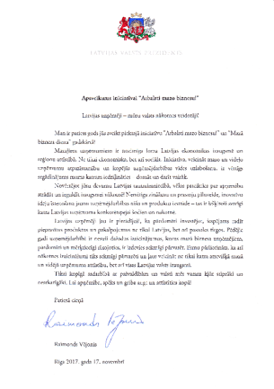
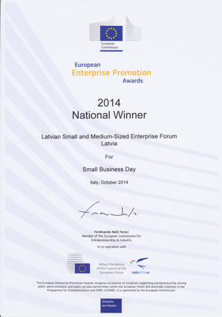

Awards
Awards

Slide 13
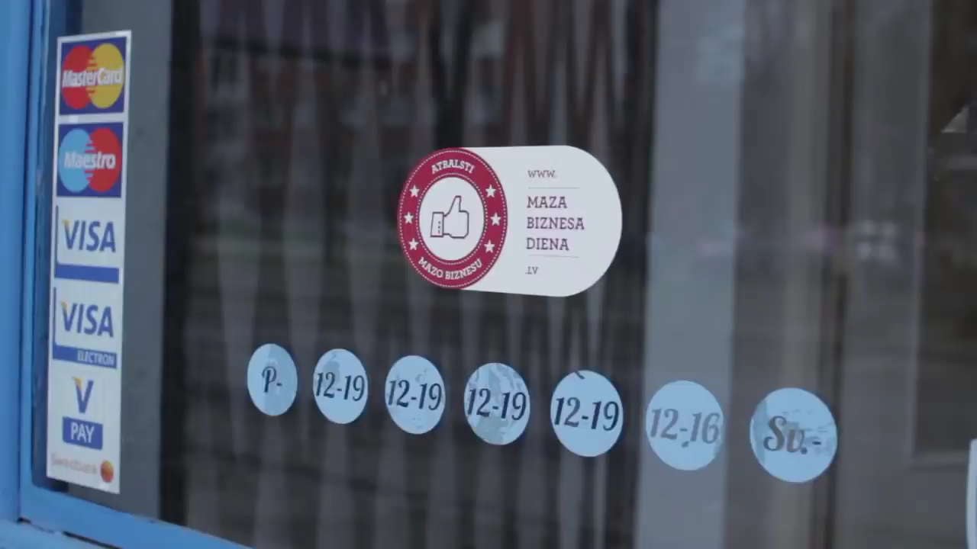
Official promotion

Slide 14
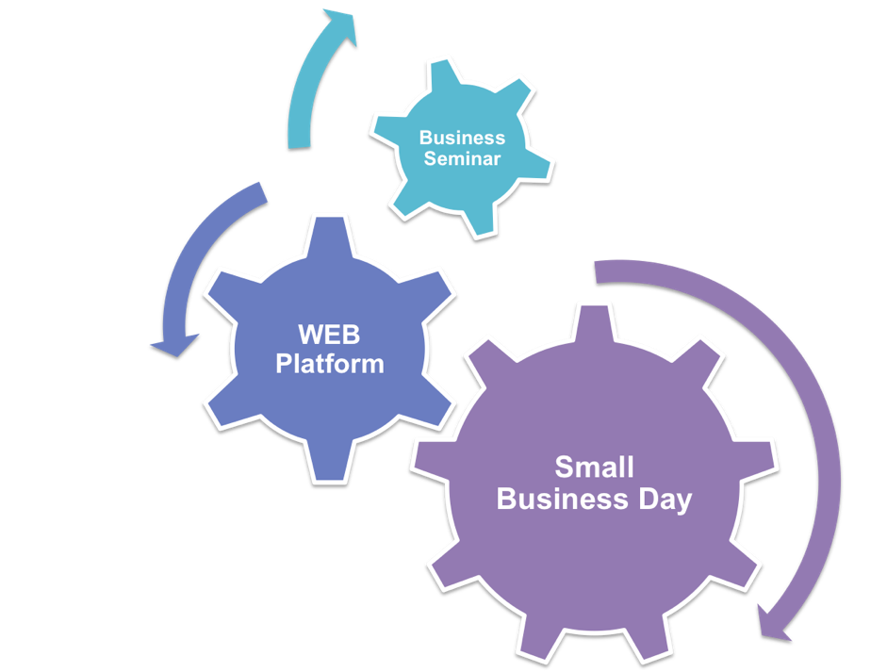
Main pillars
Business seminars
SMEs seminars in largest cities of Latvia (6);
Infomarket;
Discussions
Business webinars
Web platform
Startup manual
Expert advice
Forums
B2B
Linked information
Legislation
Small Business Day
Public initiative in whole Latvia- similar to USA“SHOP SMALL” project;
Supported by media (radio, TV, printed, web)
Supported by local municipalities.

Slide 15
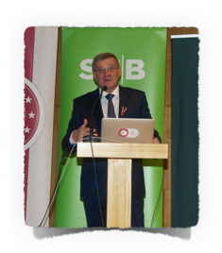
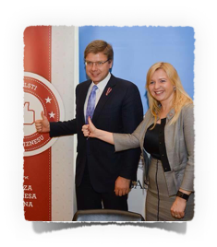
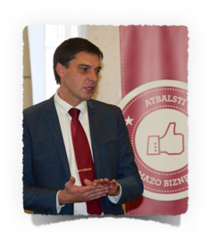
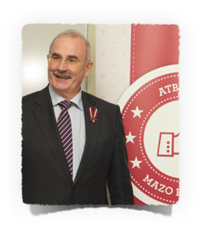
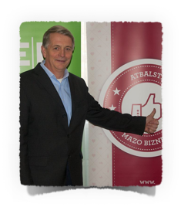
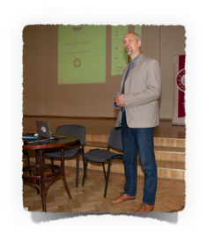
Business seminars in biggest cities of Latvia
“Mazā biznesa pēcpusdiena/Small business afternoon”

Slide 16
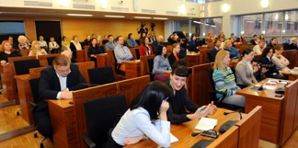
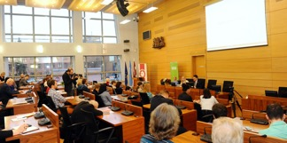






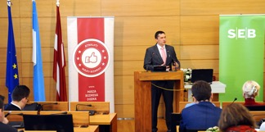
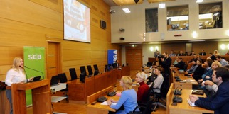



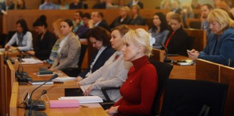
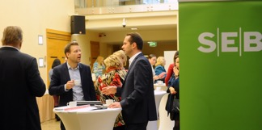






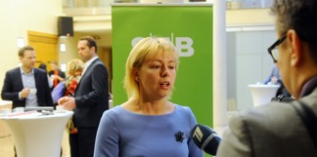
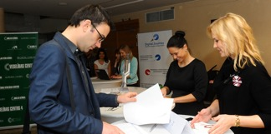



One main annual event in the capital
“Mazā biznesa diena Rīgā un visā Latvijā”

Slide 17





































One main annual event in the capital
“Mazā biznesa diena Rīgā un visā Latvijā”

Slide 18
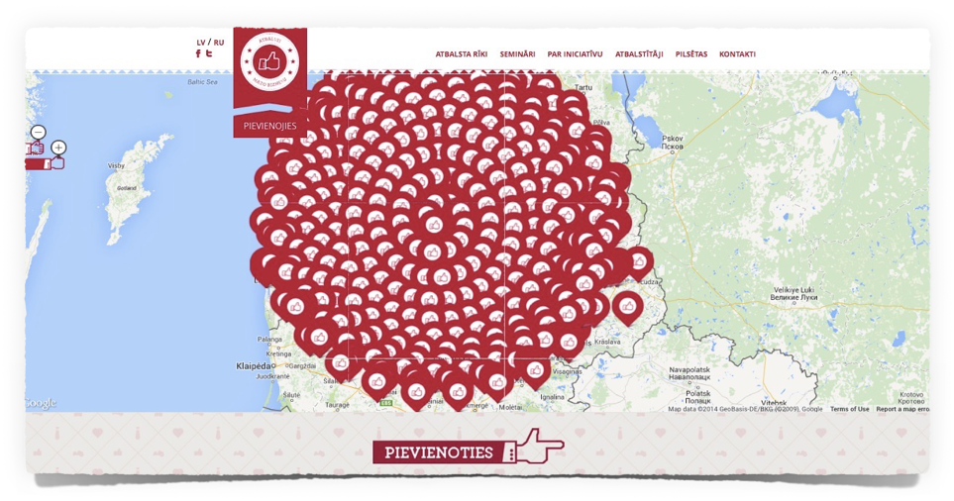
Web platform www.mazabiznesadiena.lv
There are more than 6200 enterprises on the map, 11 500+ unique visitors per month, Number of visitors 15 000, 54 000 page views (average spent time 4,5 min.)

Slide 19
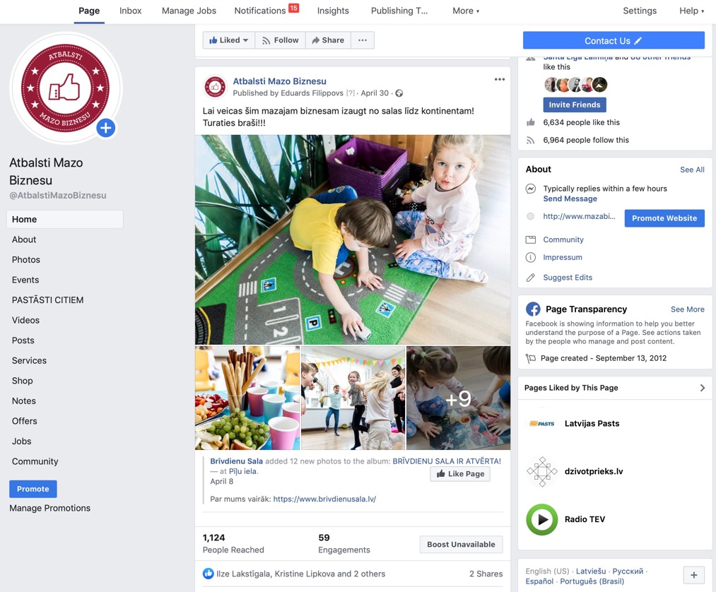
Power of social media
Initiative's social media channels show permanent growth. Facebook and Twitter has 6,964 and 767 followers respectively.

Slide 20












More than 3000 Small Business Posters

Slide 21
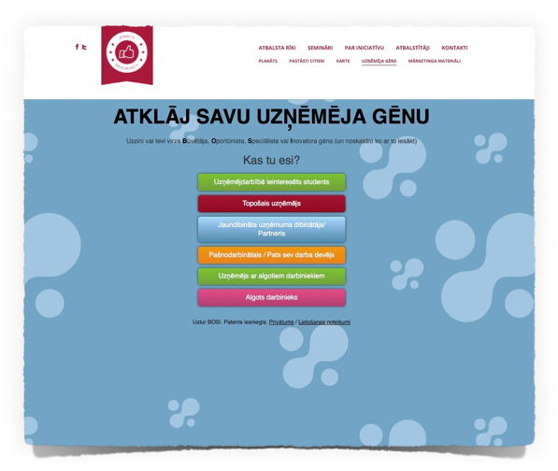

Evaluate your entrepreneur DNA!
A bit of practical science
BOSI DNA
Self evaluation test has been completed by 9000 people!
http://mazabiznesadiena.lv/atbalstariki/bosi

Slide 22
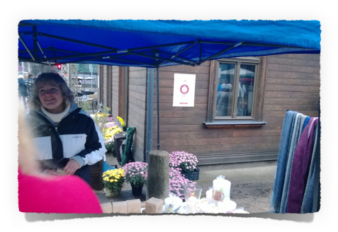

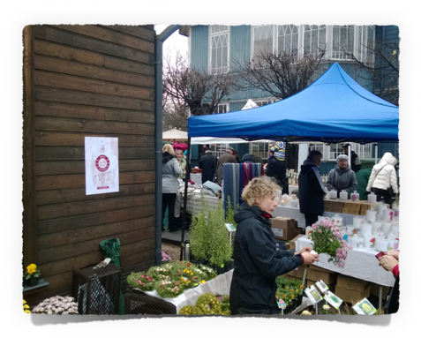
Markets, events and more to celebrate Small Business Day

Slide 23

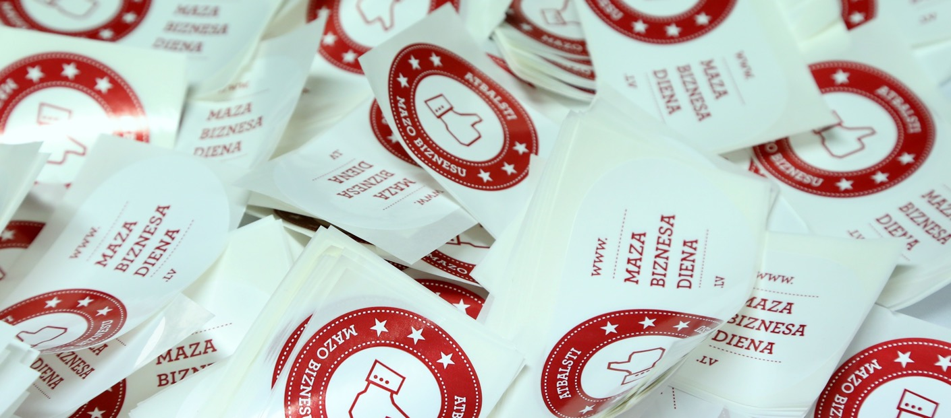
Powe of Media

Slide 24
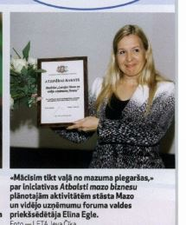
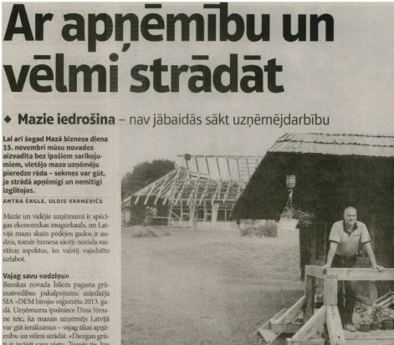
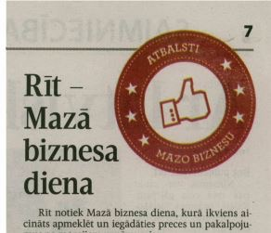
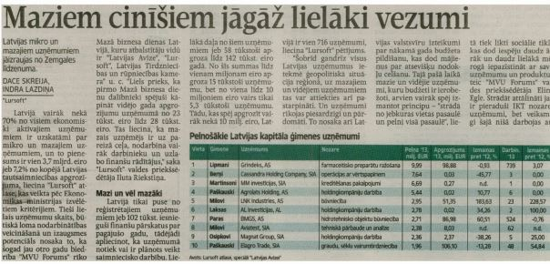

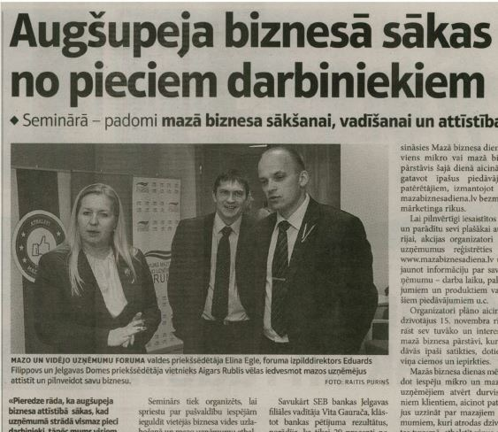
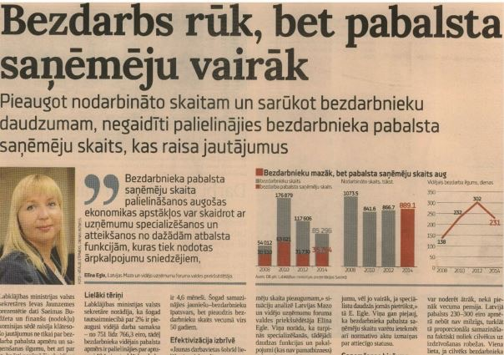
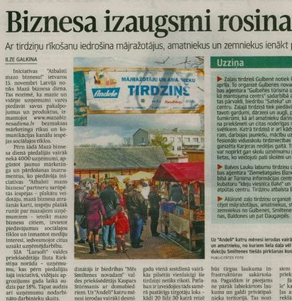
Latvian language

Slide 25

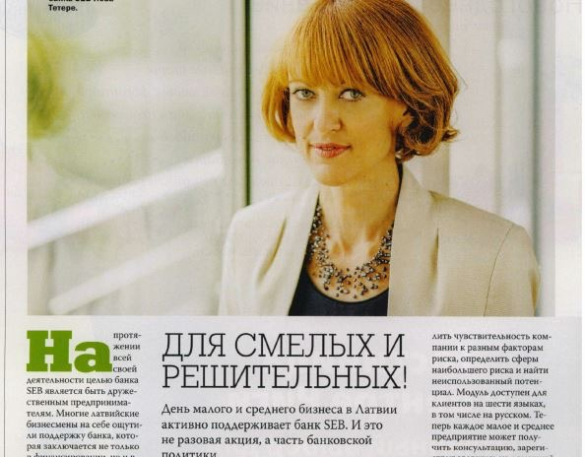
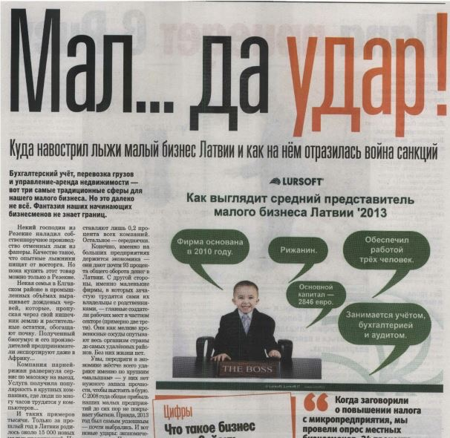
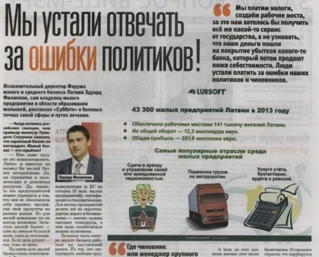
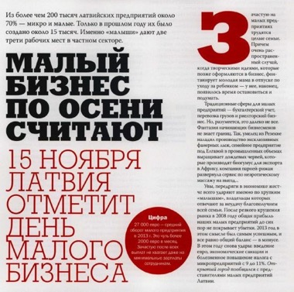
Russian Language

Slide 26
Next step more regional.
Index
„Most Investment-Friendly Municipality“

Slide 27
Purpose
Main purpose is sharing of best practice among participating municipalities;
Send rigt signals to businesses and even households;
The index is developed within the Business Union of Latvia initiative “Support Small Business”. Initiative “Support Small Business” and Small Business Day are supported by the municipalities of Latvia, the Ministry of Environmental Protection and Regional Development and “Lursoft”.
The index, which consists of a quantitative or statistical section and qualitative or municipal assessment according to the activities implemented to promote entrepreneurship in their territory, shows that it is not always only the large municipalities that are most capable of promoting entrepreneurship. To the contrary, the index approves that in the regions with a regional development centre and in the regions with a local development centre, a wide range of support measures for the promotion of entrepreneurship, tailored specifically to the particular situation of the municipality and to the needs of the entrepreneurs is being implemented. Municipalities demonstrate that cooperation is also very important – at a local and regional level, by being involved in various activities with business-related institutions, in order to strengthen the competitiveness and popularity of municipality entrepreneurs.

Slide 28
Methodology
Part I. Statistics about 2017 in the following indicators (40% proportion in the index; SIA “Lursoft” calculations):
  The number of active entrepreneurs per 1000 residents:
  The number of employees in the companies of the region in relation to the population (data of 2016), (%)
  Total turnover (data for 2017; thsd. EUR) per 1000 residents
  Total profit (data of 2017; thsd. EUR) per 1000 residents
  Corporate Income Tax (data of 2017) per 1000 residents
  The mentioned statistical indicators were selected to reflect the results of the entrepreneurs in a concise manner and to assess the positive contribution of the entrepreneurs to the municipality and society. The index does not include state and municipal enterprises, their financial indicators.
Part II. The assessment/nomination of the planning regions, in which the activities organised by the municipalities for the promotion of entrepreneurship and investments in the establishment of a friendly environment (60% proportion in the index) were evaluated.
  In accordance with the Regional Development Law, the competence of the planning region includes the promotion of economic activity in the territory of the planning region. For the provision of this competence each of the planning regions has established business centres that have a coordinating role at the regional level between state, municipality and non-governmental institutions supporting business and the area of business promotion.
  Business centres of the planning regions are stakeholders of a regional level or the competent involved parties, that provide a bottom-up assessment within the region about the performance of the municipality in the area of business promotion.
  Within the preparing of the index “Most Investment-Friendly Municipality” the planning regions nominate the TOP 3 municipalities from each region, by providing descriptive information about the following aspects:
  The accomplishments and achievements of the municipality in implementing the support measures for promoting entrepreneurship (including the establishment of business support infrastructure);
  Cooperation of the municipality with various organisations in business promotion activities.
Part III. The ratings of the quantitative data results and the qualitative data results are summarised using the weighted average of ratings.

Slide 29









Index awards 2018
The nomination: Regions of regional level development centre (21) Aizkraukle region Dobele region Kuldīga region Special success in Madona and Gulbene regions | The nomination: Regions of local level development centre (89) Mārupe region Olaine region Jelgava region | The nomination: National level development centres of the Republic’s cities (9) Ventspils Valmiera Liepāja

Slide 30
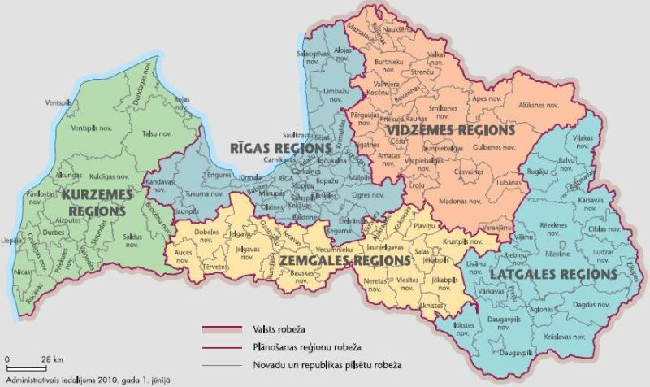
Other regional activities and iniciatives
Planning region level (5)
  Planning regions are responsible for promoting economic activity in the planning region's territory. In each of the planning regions, there are business centres in place which have a coordinating role at regional level between institutions, local government and non-governmental sector and entrepreneurship.
  The business centres of the planning regions are the regional stakeholder to provide a bottom-up assessment of municipal performance in business promotion within the regions. Main activities:
    Grant programs, access lo finance and loans;
    Business incubators;
    Regional business forums, awards, events and fairs;
    Permanent dialog structures.
Municipality level (119)
  Youth empoyment, workplace based training;
  Couching and mentoring;
  Business localiozation;
  Infrastructure development;
  Promotion of digitalization and energo efficiency;
  Real estate tax discounts.

Slide 31

Contact me:
Eduards Filippovs
Business Union of Latvia, Chairman
eduards.filippovs@savieniba.lv
www.savieniba.lv
www.mazabiznesadiena.lv

