Slide 1

Regional SME support strategies – case Ukraine
Qazakh, June 17
Regional SME support strategies – case Ukraine
Regional SME support strategies – case Ukraine
The project “Development of SME strategies and its impact on regional SMEs” benefits from support through the EaP Civil Society Forum Re-granting Scheme (FSTP) and is funded by the European Union as part of its support to civil society in the region. This material has been produced with the assistance of the European Union. The contents of this publication are the sole responsibility of project implementing partners and do not necessarily reflect the views of the European Union.

Slide 2

SME Development Policy in Ukraine at Regional and Local Level
Report Commissioned by FORBIZ
Regional package of USAID LEV Program: from ideas to praсtice

Slide 3

State Strategy for Regional Development of Ukraine 2020

Slide 4
According to existing legislation, the Strategy for Regional Development is a government tool for regional development and the only strategic document that:
Is obligatory for development and implementation for governmental bodies for both regional and local levels
Is a common and understandable tool for administrations at all levels, together with a manual, which has been adopted by Cabinet of Ministers in 2004 and revised at every round of the planning process
Foresees consistent strategic planning at the regional level after the national Strategy is adopted. In this way the Strategy forms a comprehensive and systematic approach to regional development planning
Has governmental financial tools, such as Regional Development Fund, Structural Budgets (other EU funds) etc. were composed to fund activities under all national and regional level strategies

Slide 5
The basis of strategic planning and implementation of Regional Development Strategies (and other strategies for socio-economic development) is important to the integrity of the chain of documents of “national level - a regional level – amalgamated territorial community level – city level - a village”. The strategies at these levels should not be contradictory. The mutual agreement of the development and implementation of action plans at all levels can ensure effectiveness of the entire system of strategic planning in the context of the national economy.
The State Strategy for Regional Development 2020 defines economic development generally and business development particularly as one of its priorities:
“The Strategy is aimed at defining objectives and instruments for solving social problems, increasing the level of economic potential of territories, their economic productivity, profitability of business and income of the population, and, consequently, creating conditions for general increase of social standards, quality of life and development of business environment.”

Slide 6
State Strategy for Regional Development 2002 sets the basic background for SME and business development as a part of economic and social aspects of regional growth. At the same time the existing measures cannot be considered as a comprehensive policy for SME development and should be strengthened through the preparation of targeted strategic documents, within the framework of the approved national SME Development Strategy.
The State Strategy for Regional Development sets a background for further horizontal and inter-level coordination of objectives and activities of the Regional Development Strategies with priorities of other sectoral policies, including economic development and investments, entrepreneurship, business and regulatory environment, competition policy, labour market, education and science, innovations.

Slide 7
The implementation instruments of State Strategy for Regional Development compose of the Action Pan for State Strategy, Regional Development Strategies and their Action Plans, as well as the State Target Programmes. All mentioned instruments need to be used in cooperation in order to avoid duplication of activities envisaged by them.
Authorities implementing the strategy include Ministry of Regional Development, City and Oblast Councils; Oblast and Rayon State Administrations; Associations of local Self-Government Authorities and Regional Development Agencies; Donor organizations and international financial institutions, which provide technical assistance and credit resources for creation and implementation of state regional policy are also involved in the process of regional development in one form or another, directly or indirectly.
Despite of availability of various financial tool for funding the strategy, according to the statistics, the programmes with economic focus are not exceed 2% of all the applications were sent to Fund for Regional Development and Sectoral Budget for 2014-2017 years. This indicates the necessity for future strengthening of the economic focus (including business/SME development) of the Regional Development Strategies, which may be partly covered by activating SME related programmes in parallel with awareness raising and capacity building of regional/local authorities.

Slide 8
SME development scope in the Regional Development Strategies 2020

Slide 9
The region/oblast is an administrative unit according to existing territorial organization in Ukraine. The regional development strategy is a strategic plan for the development of the region that defines the goals, tasks, priorities, direction of sustainable economic and social development of the regions and cities of Kyiv and Sevastopol for the medium-term (4-6 years) and long-term (10-15 years) periods.
The Regional Development Strategies take into account national priorities, regional competitive advantages, constraints, threats and problems of the region, priorities for development, coordinated actions of stakeholders aimed at realization of certain tasks, and the basis for their solution.
Regional development strategies are prepared for a period that is consistent with the implementation period of the State Strategy for Regional Development, and includes, both objectives determined at regional level and prescribed by the State Strategy for specific region(s). The documents are developed by regional, Kyiv and Sevastopol city state administrations involving district and city councils, public associations and approved regional, Kyiv and Sevastopol city councils.

Slide 10
The logical Structure of Strategic objectives should include following directions:
Economic development, which includes problems, factors for target industries and companies; improvement of economic capacity and competitiveness of the region; improvement and acceleration of restructuring of regional economy
Social Development: Availability of quality services for different target groups
Development of sustainable community; Strengthen of social integration and social capital; Improvement of public services
Protection of the environment
As for the Economic Development direction target groups are:
- Existing companies already operating in the region
- New companies that are at the preparatory stage or just started to work
- Foreign investors who are looking for opportunities to set-up or expand their business

Slide 11
Current SME content of the Regional Development Strategies 2020

Slide 12
All 24 regions of Ukraine have active Regional Development Strategies for period until 2020, as well as Action Plans for their implementation. Most of the oblasts prioritize the development of SMEs and entrepreneurship skills in regional/local policies but historically these directions do not have adequate funding from local budgets, which means that it is essential to connect up with alternative source of financing for effective implementation.
In order to assess the existence and quality of SME scope in the Regional Development Strategies, nine oblasts situated in different parts of the country were selected, with various size, profile and level of economic development. These were: Cherkasy, Chernihiv, Ivano-Frankivsk, Kharkiv, Mykolaiv, Ternopil, Sumy, Lviv and Poltava oblasts.

Slide 13
Among the most frequent measures related to development of the SMEs in the Regional Development Strategies of above oblasts were:
- Development of business support infrastructure (Cherkasy, Chernihiv, Ivano-Frankivsk, Mykolaiv, Ternopil, Lviv and Poltava oblasts);
- SME competitiveness (Chernihiv, Ivano-Frankivsk, Kharkiv, Ternopil oblasts);
- Informational support / consultancy for SMEs (Cherkasy, Ternopil, Lviv oblasts);
- Access to finance, microcredits for SMEs (Ternopil, Sumy, Lviv, Mykolaiv oblasts);
- Development of SMEs/entrepreneurial skills in rural areas (Ivano-Frankivsk, Ternopil oblasts).

Slide 14
SME development scope in Local/City Development Strategies 2020

Slide 15
The City Development Strategies are strategic planning documents which are developed by city councils and their goal is to establish the long-term priorities for local development. The city development strategies are planned to become a local link in strategic planning tool of the system: Regional Development Strategies – State Strategy for Regional Development – Strategy for Development of Ukraine 2020.
At the same time, city councils are self-governing bodies which operate according to their own legislation and statutes. This gives them more flexibility regarding the substance of the document and identification of strategic direction and vision of the city development.
- Some of the strategies are long-term and have different timeline compared with the governmental strategies for development of the regions
- Most of the Strategies do not seek coordination with strategic documents of other levels (Regional Strategy) and none of the strategies seek coordination with national sectoral strategies during development of strategic directions and appropriate measures

Slide 16
- The basic composition of the strategic objectives in City Development Strategies is similar to what is proposed in the Methodology for Regional Development Strategies and include economic, social and environmental directions
- Strategies include SWOT analysis and identify the strategic objectives on the basis of it
- The City Development Strategies have a much focus on the necessity of PPD and involvement of the community/private sector into policy-making process then the Regional Development Strategies
- In contrast to the Regional Development Strategies, the formulation of the strategic directions in the City Development Strategies are much more geared to citizen, using easy to understand language
- Not all the Strategies contain information about the implementation stages, so it is not possible to identify if the documents have Action Plans or not
- The documents have different monitoring and evaluation procedures, most of which do not corresponds with established good practice

Slide 17
Chernihiv City Development Strategy 2017-2020, the SME focused issues are at the level of sub-objectives, namely: Improving the business environment” and “Development of PPP” with a number of related measures.
Vinnitsia City Development Strategy 2020 includes two sub-objectives of the Economic Development strategic objective, namely: “Favourable business-climate for sustainable business development” and “Infrastructure for SMEs” but there is no Action Plan, though it does demonstrate a degree of coordination with the strategic objectives of the “Europe 2020” Strategy.
The Strategy for Development of Khmelnitsky City promotes itself as the “City for Entrepreneurship” and this forms the first of three strategic objectives. The Strategy includes 14 measures within this Strategic objective, including awareness raising and creating of positive image of entrepreneurs, attracting investment, ease of doing business, creation of IT clusters and techno parks. The Strategy will be supplemented by the Action Plan. The Strategy also identifies three Programmes within this direction which will become implementing tools: SME Development Programme, Programme for International Cooperation of Khmelnitsky and Programme for Financial Support of City Development Agency.

Slide 18
National SME Development Strategy 2020

Slide 19
The National Strategy for SME Development 2020 is the first Strategy for development of the small and medium enterprise sector in Ukraine and was adopted by the Cabinet of Ministers on 24th May 2017.
The Strategy development took into consideration international good practice including EU Small Business Act (SBA) as a basis for its structure.
The document creates the framework of the national SME development policy in Ukraine and includes the Action Plan (put out for consultation and currently being finalised) as a mechanism for its implementation.
It also foresees creation special tools for monitoring and evaluation, as well as coordination between all key levels and between key stakeholders.
The Strategy consists of six strategic objectives:
- Creating a favourable environment for SME development;
- Improving an access to finance for SME;
- Simplifying Tax Administration for SME;
- Promoting Entrepreneurial Culture and Developing Entrepreneurial Skills;
- Promoting SME Export / Internationalisation;
- Improving competitiveness and developing the innovation potential of SMEs.

Slide 20
Within each of the strategic objectives, the Strategy proposed various measures and instruments such as:
Improving Information Provision Including Enhancement of the State Statistics System;
Streamlining Bankruptcy Procedure and Promoting the "Second Chance";
Intensifying Use of Promissory Notes;
Developing and Promoting Entrepreneurship Culture;
Encouraging Employers to Train their Employees;
Fostering Development of Social Entrepreneurship;
Launching Target Initiatives with Regard to Clusters and Value Chains.
The proposed measures have different scope and relate to both national and regional levels. All the various existing tools compose a complex mechanism for entrepreneurship support within the national scope.

Slide 21
The Action Plan represents a practical framework for implementing the Strategy. The Action Plan describes how the measures proposed in the SME Strategy may be implemented and defines the necessary details for monitoring and implementation of the document. The Action Plan is in the form of a table with following columns: measure, rationale, timeline, responsible body(ies) and indicators.
The Action Plan for SME Strategy 2020 consists of 98 measures to be implemented by the end of 2020.
It is expected that the Strategy will be implemented partly with funds allocated from the state budget by the authorities responsible for the measures defined in the Strategy, supplemented with support from international technical assistance projects and funds from other resources not prohibited by law.

Slide 22
Neither the Strategy nor the Action Plan have an explicit regional dimension and do not oblige regions/cities to implement specific measures. Both documents leave scope for oblasts/cities to define appropriate tools and to define the regional/local SME policies according to the local specificities, strategies, needs and priorities, which are in line with the decentralisation reform taking place in the country.
This means that the regional/local SME development policies should be developed as an integral part of the policies for regional/local economic development and their measures should be coordinated with other relevant documents. Such an approach would form a vision of further development of individual regions.
From the other side, SME policies at the regional/local level should be consist with the national SME Development Strategy, as well as with the EU SBA principles. This coordination should be secured at the stage of drafting and defining the strategic objectives.

Slide 23
Regional SME Development Strategies

Slide 24
The important role of regions and cities in SME development is explained by the fact, that regional and city government are accessible to the business sector, can meet representatives of SMEs, information on the economic situation and problems in the region, a good understanding of the needs of SMEs, etc. Such issues as training for SME employees, business-consultancy, administration of business procedures, etc. are usually resolved at the regional/local level.
Development of SME policies at the regional level have to ensure a consistent long-term perspective. The common approach for drafting regional/local SME policies in Ukraine is to develop a number of short-term Programmes, what have and appropriate legal base. Despite of this, there have been several attempts since 2010 to develop SME Strategies at the regional level.

Slide 25
Donetsk regional SME Development Strategy 2011-2016 - GIZ
The first SME Strategy was drafted by Donetsk Oblast Administration in cooperation with the GIZ programme. It started in 2011 but had to terminate implementation in 2013 because of the political crisis and military conflict in the region. The Strategy defined the following strategic objectives: prioritize SME as a strategic sector for local government; establish sufficient SME support infrastructure; support SME friendly regulations; activate of innovation and investment systems in Ukraine. During the development the Strategy was coordinated with the Regional Strategy for Social and Economic Development of Donetsk Region 2015.
There are some weaknesses in the approach: SWOT and risk analysis are absent from the document, it does not coordinate with Small Business Act or other national level strategic documents and principles. The Donetsk regional SME Development Strategy 2011-2016 does not foresee mechanisms for further implementation, monitoring and evaluation. Overall, the document has mostly declarative in nature and cannot be considered as an effective element of the planning system. The Strategy represented an initial attempt to develop a long-term planning document for SME development at the regional level but cannot be considered as a good practice example for the development of the future regional templates.

Slide 26
Regional SME Development Strategy 2020 piloted – USAID
Currently, six regions of Ukraine are working on development of regional strategies for SME development. The assistance in development of these documents was provided by USAID programme LEV (Leadership in Economic Regulations), which has been working in Ukraine since 2014and its goal is to improve business-climate by drafting SME policies and simplifying regulations which burden SME development.
A strategic planning exercise was done with five target regions: Kherson, Kyiv, Lviv, Ternopil and Vinnitsia; Cherkasy oblast became the sixth region at the end of 2016 year. Currently, all SME Strategies have been adopted.
The overall approach of the LEV programme is to develop the regional SME Strategy as an intermediary document between the Regional Development Strategy and Programmes for SME development

Slide 27
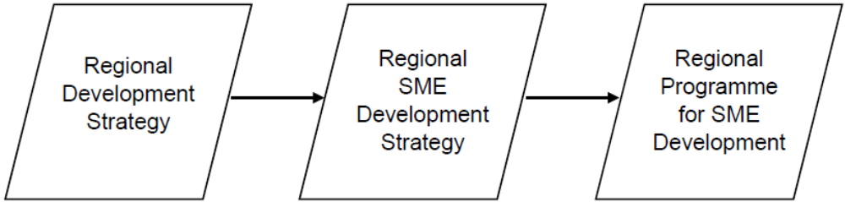
The document considers the strategic objectives and SME-related measures of the Regional development Strategy and expands upon them. The LEV programme´s methodology is mostly concentrated on coordination with the Small Business Act principles and providing recommendations about how to ensure the step-by-step development of regional policy. This is well reflected in the SME Strategies of Ternopil and Cherkasy oblasts, for example.
Taking into consideration the fact that the national SME Development Strategy 2020 was also developed on the basis of SBA, we compared strategic objectives and tasks of both national and regional SME strategies.

Slide 28
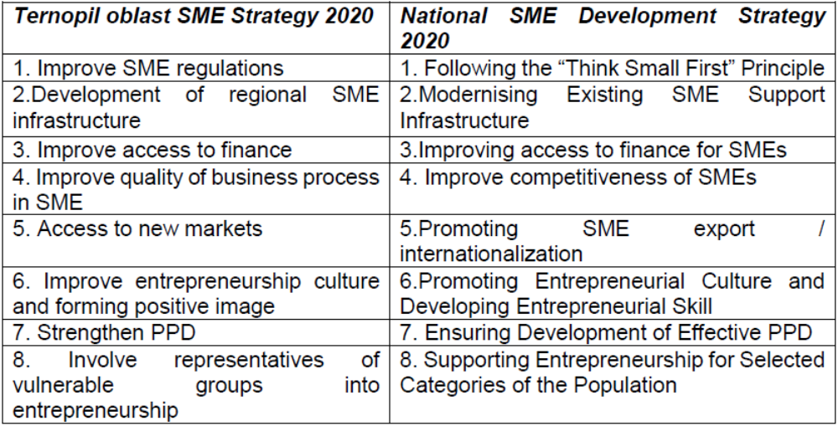

Slide 29
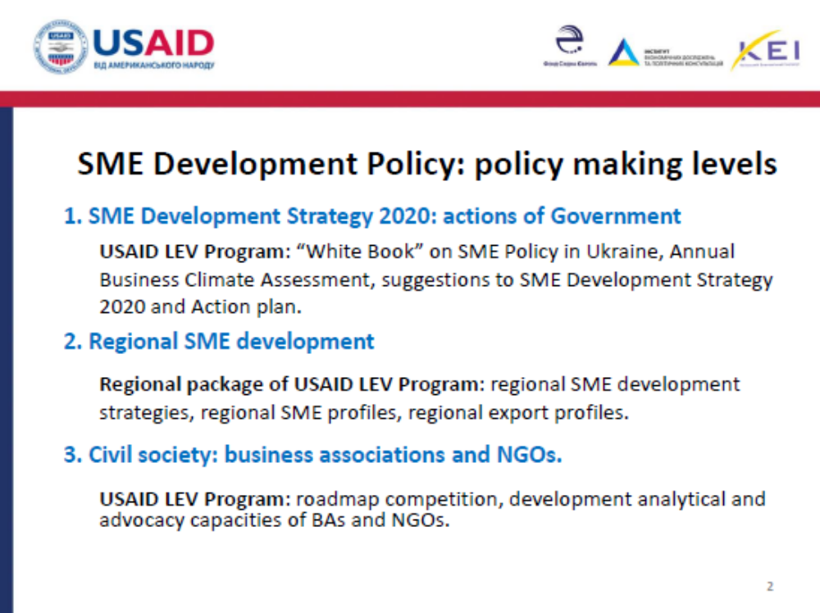

Slide 30
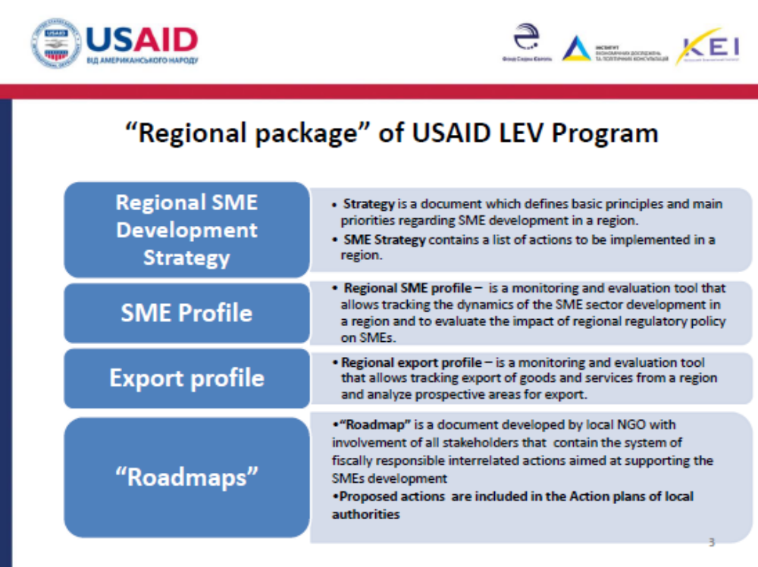

Slide 31
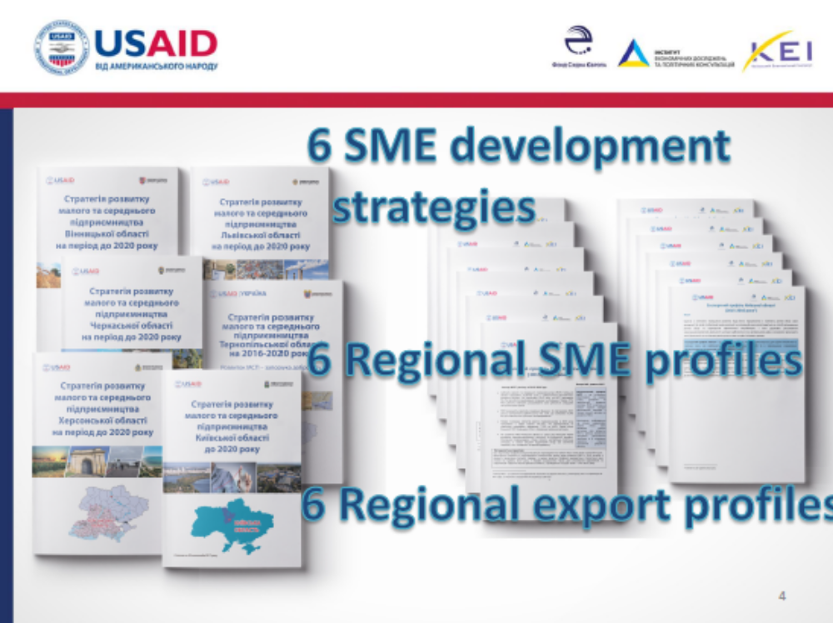

Slide 32
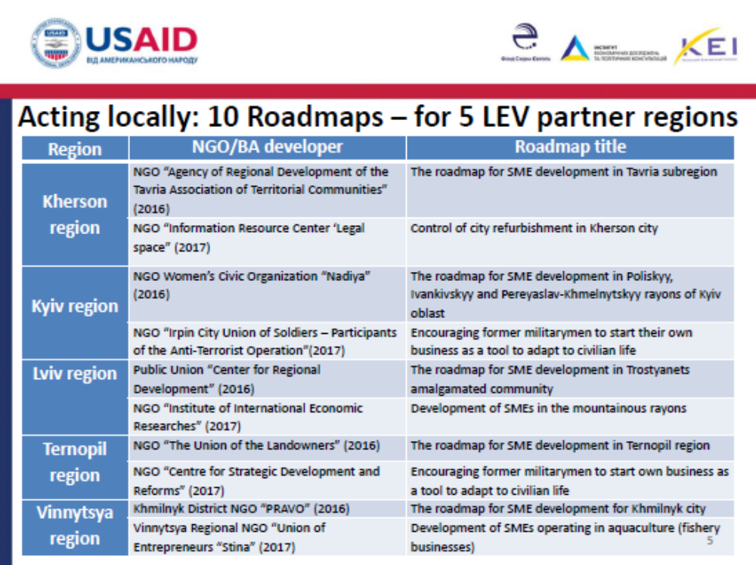

Slide 33
Programmes for SME Development as a medium-term policy

Slide 34
Regional and local planning documents, which are concentrated on SME development and represented in Ukraine according to the acting legislation may be divided to two main groups:
Regional long- and short-term documents, which contain SME development issues as a part.
These are the Regional Development Strategies (According to the Law “On State Regional Policy”) and short-term programmes for economic and social development (Law of Ukraine “On State Forecasting and development of Programmes for economic and social development”).
Regional planning documents fully devoted to SME issues.
These are regional and local Programmes for SME development (Law of Ukraine “On National Programme for small and medium entrepreneurship development in Ukraine”)

Slide 35
The development of SME Programmes is regulated by the Law on National Programme for SME Development in Ukraine. This Law was adopted in 2000 and sets the main directions of the National Programme, which are:
Improvement of the regulatory framework for entrepreneurial activity
Comprehensive state regulatory policy in the field of entrepreneurial activity
Intensification of financial-credit and investment support to small business
Development of support infrastructure for small entrepreneurship
Introduction of the regional policy for SME development.
The National Programme also has the Action Plan for the year 2001, which includes measures, expected results, timescale, responsible bodies and budget.

Slide 36
The existence of the national-level Programme implies development of relevant medium-term documents at the regional and local level. However, since the last update of the National Programme for SME Development took place in 2001, it is obsolete as a framework for current SME Programmes.
To coordinate the process of drafting of the regional/local SME Programmes, Guidelines were developed by the State Regulatory Service in 2010 with allowance for the Laws of Ukraine "On Development and State Support of Small and Medium-Sized Enterprises", "On Stimulating Regional Development", "On National Programme for Facilitating SME Development in Ukraine", "On State Forecasting and Formulation of Ukraine Socio-Economic Development Programmes" and other laws and regulations.

Slide 37
Developing and implementing the Programmes include a number of stages:
Comprehensive Analysis of the Actual Situation with Development and Support of SMEs in a Region
Identification of Priority Areas of SME Support in the Region
Development of Programme Tasks and Measures Needed to Accomplish the Programme Tasks
Monitoring the Progress in Implementing Regional and Local SME Development Programmes and Specific Measures under these Programmes

Slide 38
Programmes for SME Development at Regional/Local Level

Slide 39
During the developing process, most of the state bodies follow the methodology proposed by State Regulatory Service. The Programme usually consists of an analytical overview of the SMEs in respect to their influence to economic development. In some oblasts this analysis is accompanied by a SWOT analysis. The other notable parts of the Programmes are tables in the form of Action Plans with following information: measure, rationale, responsible, timeline, expected cost and amount of funding.
Most of the Programmes have two-year timeline. The SME issues in Kyiv are included into the Kyiv Programme for Development of Entrepreneurship, Industry and Market. Some of the regions, such as Poltava, Kharkiv and Chernihiv, have the Programmes with a timeline of 2016/2017 - 2020.

Slide 40
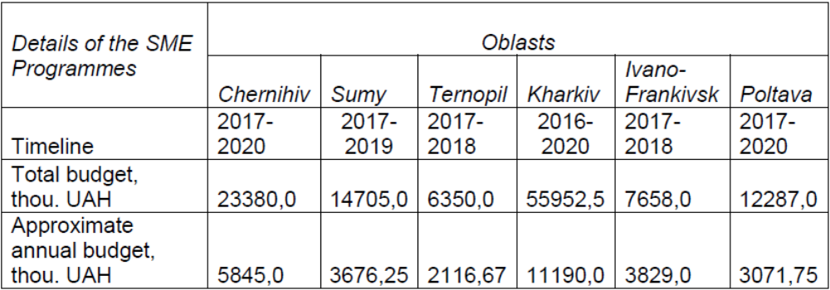
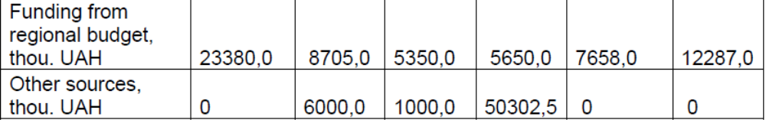
Sources of funding for SME Development Programmes
Some of the Programmes are expected to be funded exclusively from regional budget and some others foresee the involvement of alternative funds, donors and private funds.

Slide 41
Among the measures typically funded from oblast budget are:
- Micro-credits and loan interest subsidies (Entrepreneurship Funds);
- E-services for entrepreneurs;
- Trainings on entrepreneurship/ Rural Development;
- Participation in exhibitions, fairs and conferences;
- Development of promotional leaflets of the region.
The measures in the SME Programmes which often involve alternative sources of funding are:
- Trainings on M-test and better regulations;
- Study tours and international events;
- Projects competitions/call for proposal;
- Development of web resources;
- Establishment of business support centres.

Slide 42
Conclusions

Slide 43
1) The emergence of new element as SME Development Strategy at the national level requires appropriate changes in policy-making and implementation on regional, local and community levels, what will ensure comprehensive approach, coordination and effective implementation of SME policy in Ukraine.
2) There is no unified approach in Ukraine on development / implementation of SME policy on regional and local levels. The main SME-related planning elements which currently present on regional and local levels are: Regional Development Strategies (RDS), Regional SME Strategies and medium-term Programmes for SME Development.
3) There is an urgent need to establish effective mechanism for dialogue and cooperation between public and private sectors both at the regional and national levels. The dialogue should become background principle at the every stage of SME policy development and implementation, including monitoring and evaluation.

Slide 44
4) Regional/Local Programmes for SME Development may not be considered as potential Strategic planning documents because of their medium-term timeline and absence of necessary strategic planning approach at analytical part of the documents.
5) Regional and local SME Development Strategies may not nowadays become unified example and sustainable element of SME Strategic Planning system, as far these documents are voluntary both for development and implementation. In terms of lack of funding for SME development, optional nature of these documents, may not ensure involvement of sufficient financing for their implementation.
6) Strengthening of SME scope within the Regional Development Strategies and its coordination with national SME Development Strategy is nowadays the most realistic way to establish unified approach for development and multi-level coordination of SME policies in Ukraine. As far the RDS are the only obligatory Strategies for regions, this will ensure broad implication of the approach and enable access to variety of funding mechanisms for implementation of the policies.

Slide 45
Contacts
Center for cross-border cooperation
SME development office
yvdovenko@smedo.gov.ua

